Slide 1
Final Deliverable
Josue Sanchez
Tokio Oyama

Slide 2
GitHub Link
All the project contents are available by clicking on the next link
https://github.com/toyama541/DatabaseProject

Slide 3
Project Requirements
This days the delivery service provided by restaurants is more essential than ever. Using this queries the data can be manage to facilitate the tasks of the employees.

Slide 4
Introduction
The project will create databases to support an on-campus delivery food service website. The site will include multiple tables allowing for cross referencing of various data points. The data points include user profiles, Delivery Locations, Restaurant List, Menus and Eligibility Tables to help reference during services.

Slide 5
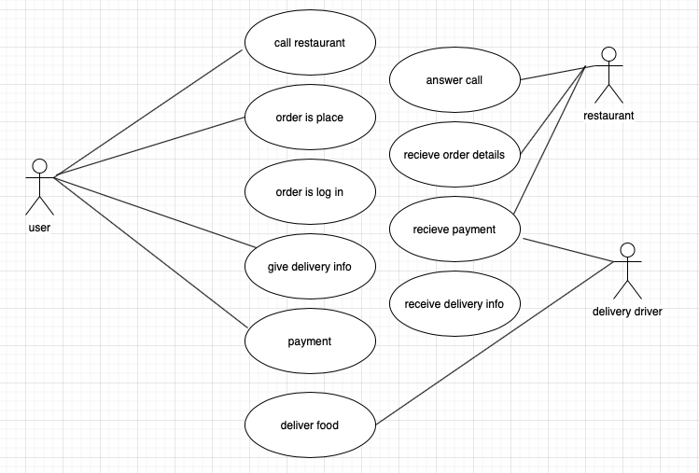
Use case

Slide 6
Business Rules
Create Tables to identify data points and variables needed to run the site.
Person Table identifying the type of person they are and defining attributes.
Identify Locations used for on campus delivery.
Provide a location description and ID number.
All delivery personnel are students.
An individual delivery is tied to one and only one person for the order.

Slide 7
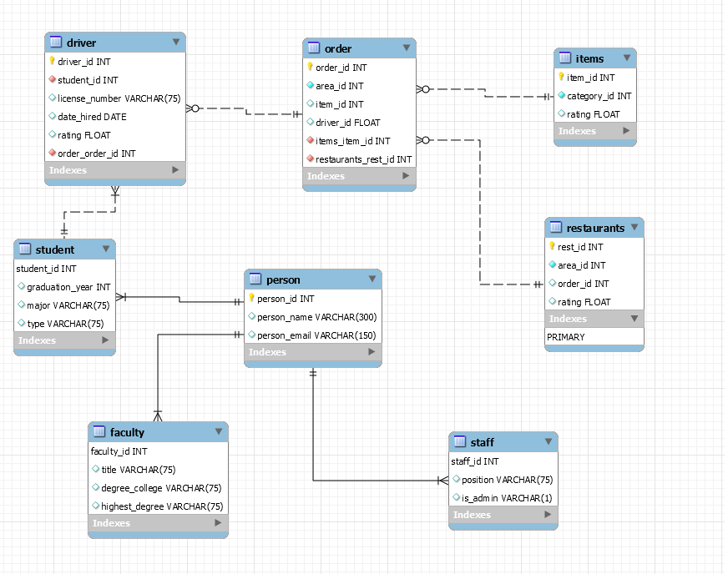
Schema

Slide 8
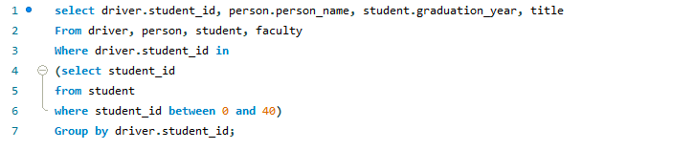
Advance View

Slide 9
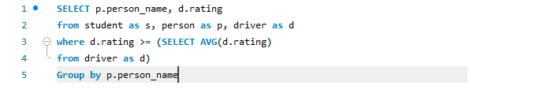
Advance View

Slide 10
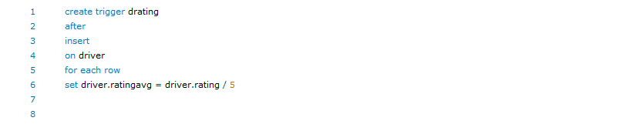
trigger

Slide 11
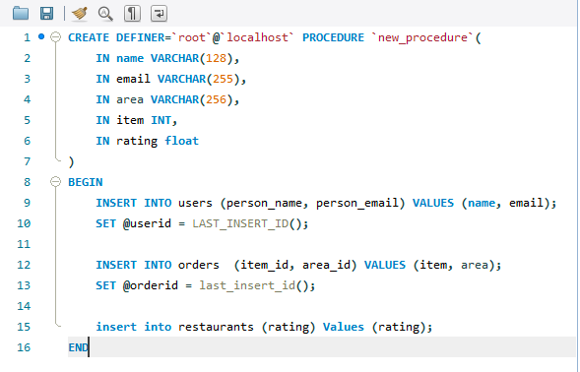
Stored Procedure

